Slide 1
STATEMENTS, EXPRESSIONS AND OPERATORS IN C#

Slide 2
STATEMENTS
A C# program is a set of tasks that perform to achieve the overall functionality of the program.
To perform the tasks, programmers provide instructions. These instructions are called statements.
A C# statement can contain expressions that evaluates to a value.

Slide 3
STATEMENTS
Statements are referred to as logical grouping of variables, operators, and C# keywords that perform a specific task.
For example, the line which initializes a variable by assigning it a value is a statement.
In C#, a statement ends with a semicolon.
A C# program contains multiple statements grouped in blocks. A block is a code segment enclosed in curly braces.

Slide 4
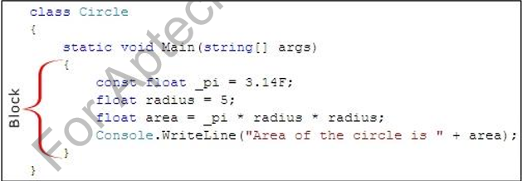
STATEMENTS
For example, the set of statements included in the Main() method of a C# code is a block.

Slide 5
STATEMENTS
Statements are used to specify the input, the process, and the output tasks of a program. Statements can consist of:
Data types
Variables
Operators
Constants
Literals
Keywords
Escape sequence characters

Slide 6
STATEMENTS
Statements help you build a logical flow in the program. With the help of statements, you can:
Initialize variables and objects
Take the input
Call a method of a class
Display the output

Slide 7
Types of Statements
Similar to statements in C and C++, the C# statements are
classified into seven categories:
Selection Statements
Iteration Statements
Jump Statements
Exception Handling Statements

Slide 8
Expressions
Expressions are used to manipulate data. Like in mathematics, expressions in programming languages, including C#, are constructed from the operands and operators.
Example: 2 + 2
An expression statement in C# ends with a semicolon (;).
The following code demonstrates an example for expressions:
simpleInterest = principal * time * rate / 100;

Slide 9
Operators
Expressions in C# comprise one or more operators that performs some operations on variables.
An operation is an action performed on single or multiple values stored in variables in order to modify them or to generate a new value with the help of minimum one symbol and a value.
The symbol is called an operator and it determines the type of action to be performed on the value.

Slide 10
Operators
An operand might be a complex expression. For example, (X * Y) + (X – Y) is a complex expression, where the + operator is used to join two operands.
The value on which the operation is to be performed is called an operand.

Slide 11
Operators
Operators are used to simplify expressions.
In C#, there is a predefined set of operators used to perform various types of operations.
These are classified into seven categories based on the action they perform on values:
Arithmetic Operators
Relational Operators
Logical Operators
Bitwise Operators
Conditional Operators
Increment and Decrement Operators
Assignment Operators

Slide 12
CLASSIFICATION OF OPERATORS
Operators are classify into 3 categories:
1. UNARY OPERATORS
2. BINARY OPERATORS
3. TERNARY OPERATORS

Slide 13
Arithmetic Operators
Arithmetic operators are binary operators because they work with two operands, with the operator being placed in between the operands.
These operators allow you to perform computations on numeric or string data.

Slide 14
Arithmetic Operators
+
-
/
*
%

Slide 15
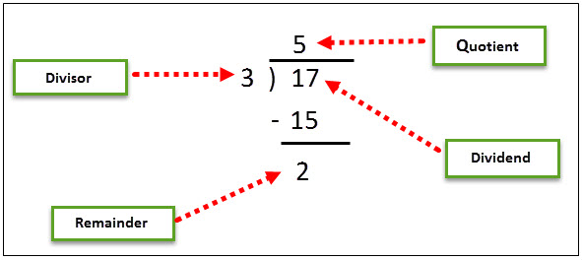
Arithmetic Operators

Slide 16
Relational or comparison Operators
Relational operators make a comparison between two operands and return a boolean value, true, or false.
==
!=
>
<
>=
<=

Slide 17
Logical OR CONDITIONAL Operators
logical operators perform boolean logical operations on both the operands. They return a boolean value based on the logical operator used.
There are two types of conditional operators.
CONDITIONAL AND (&&)
CONDITIONAL OR (||).

Slide 18
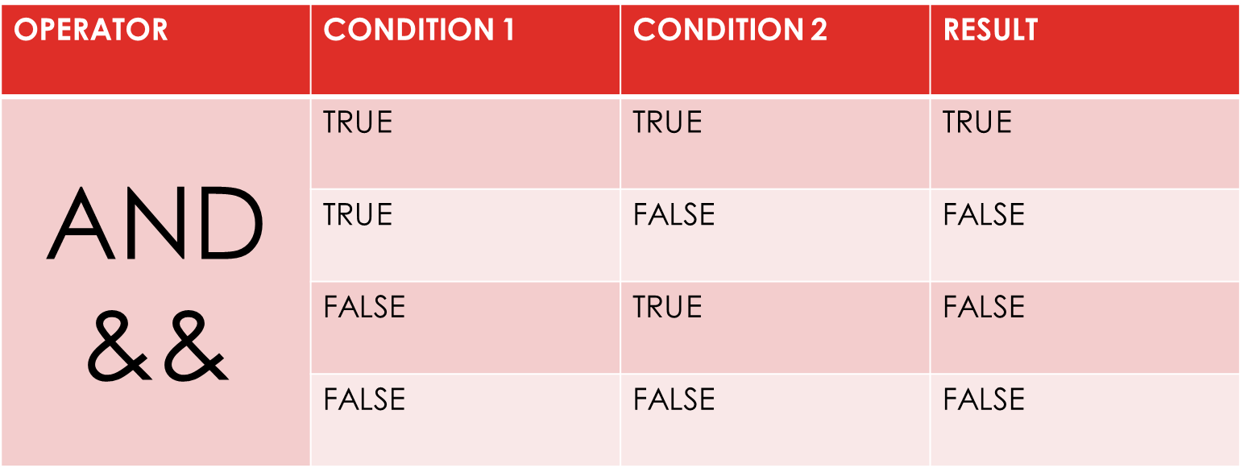
Logical OR CONDITIONAL Operators
logical operators perform boolean logical operations on both the operands. They return a boolean value based on the logical operator used.
There are two types of conditional operators.
CONDITIONAL AND (&&)
CONDITIONAL OR (||).

Slide 19
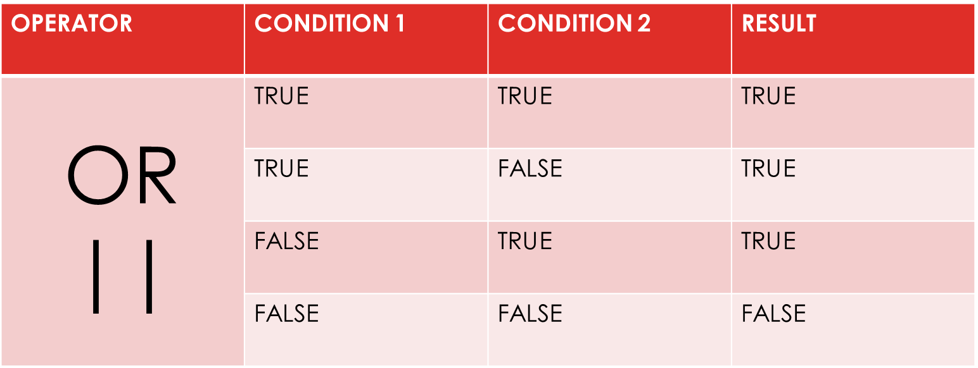
Logical OR CONDITIONAL Operators
logical operators perform boolean logical operations on both the operands. They return a boolean value based on the logical operator used.
There are two types of conditional operators.
CONDITIONAL AND (&&)
CONDITIONAL OR (||).

Slide 20
ASSIGNMENT OPERATORS
Assignment operators are used to assign the value of the right side operand to the operand on the left side using the equal to operator (=).
The assignment operators are divided into two categories in C#. These are as follows:
Simple assignment operators: The simple assignment operator is =, which is used to assign a value or result of an expression to a variable.
Compound assignment operators: The compound assignment operators are formed by combining the simple assignment operator with the arithmetic operators.

Slide 21
ASSIGNMENT OPERATORS
Compound assignment operators:
+=
-=
*=
/=
%=

Slide 22
Increment and Decrement Operators
Two of the most common calculations performed in programming are increasing and decreasing the value of the variable by 1.
In C#, the increment operator (++) is used to increase the value by 1 while the decrement operator (--) is used to decrease the value by 1.
If the operator is placed before the operand, the expression is called pre-increment or pre-decrement.
If the operator is placed after the operand, the expression is called post-increment or post-decrement.

Slide 23
Ternary or conditional operators
C# includes a special type of decision making operator ? : called the ternary operator.
Syntax:
Boolean Expression ? First Statement : Second Statement

Slide 24
PRECEDENCE OF OPERATORS
Operators in C# have certain associated priority levels.
The C# compiler executes operators in the sequence defined by the priority level of the operators.
EXAMPLE:
8 / 2 - 3 + 2 * 2

